Slide 1
Learning Object Dynamics and Interactions for Object-Centric Video Prediction
Master Thesis Seminar Talk
Ismail Wahdan
07.03.2023

Slide 2
Outline
Problem Statement
Related Work
Approach
Experiments and Results
Conclusion

Slide 3
Problem Statement

Slide 4
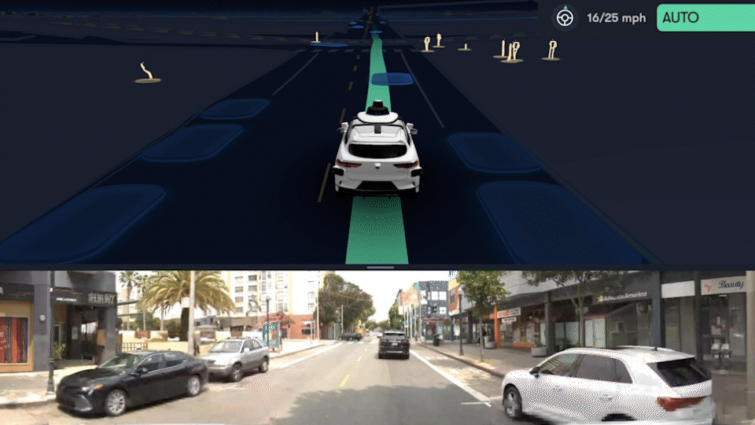
Motivation
Planning is a core ability of intelligent systems.
Requires the ability to calculate outcomes of actions.
Environment usually contains other actors and agents.
Their plans are often unknown, but their actions are observable.
An autonomous Waymo self-driving car detects the intention of someone to cross the road and stops.[4]

Slide 5
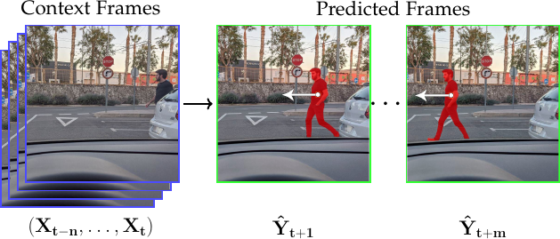
Video Prediction
Action prediction is interpreted as prediction in pixel space over frames
Given n context/seed frames, predict the following m frames
Applications: In robotics, autonomous driving, video editing
Challenges: Dynamics and rules of the real world are too complex
Source: A Review on Deep Learning Techniques for Video Prediction by Oprea et al.

Slide 6
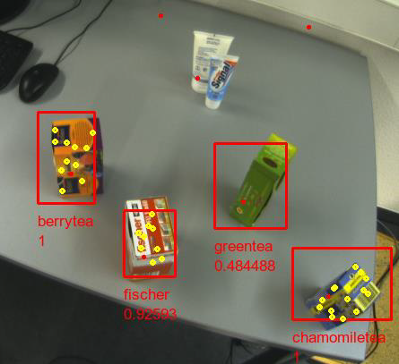
Object-Centric Learning
Humans perceive the world in terms of objects
Objects are discrete, detectable, describable
Object properties (e.g. color, location, pose, class…) facilitate modeling their interactions
Source: [Stückler, Behnke: Automatika 2011]

Slide 7
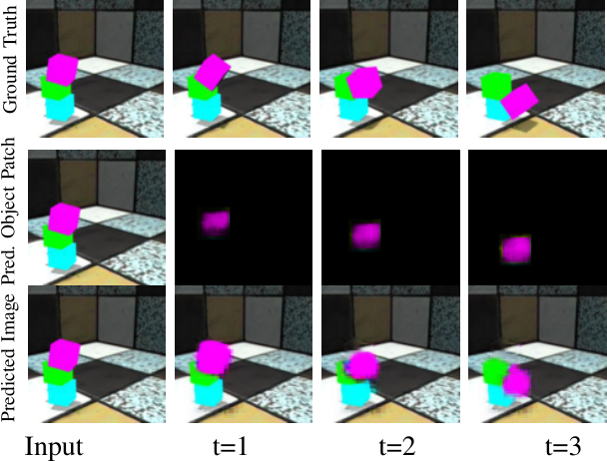
Object-Centric Video Prediction
A practical approach to video prediction
Dissect context frames into discrete objects. Predict future states of each object in an embedding space
Reconstruct the frames by decoding the predicted states back into pixel space
Source: Object-centric Video Prediction without Annotation by Schmeckpeper et al.

Slide 8
Related Work and Concepts

Slide 9
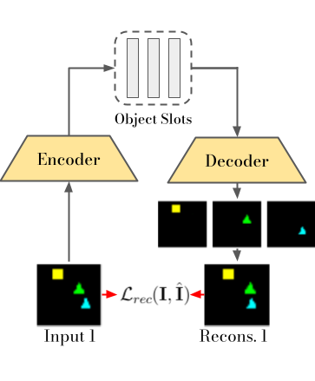
Object Slot Representation
Anticipate existence of N objects in a frame
Encoder-Decoder architecture to learn useful object representations
Hidden Space consists of slots, variables assigned to exactly one object
Usable for several downstream tasks: Segmentation, Object discovery and Set prediction.

Slide 10
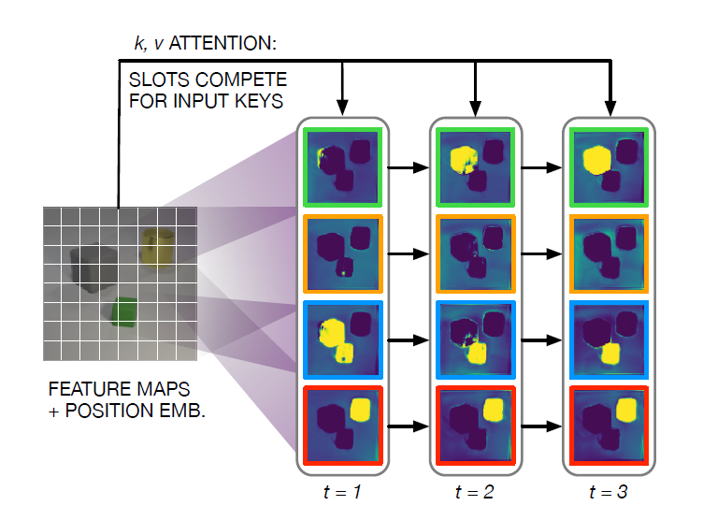
Slot Attention
Object information is collected in certain parts of a frame where object exists
Using slot attention, a slot attends to parts belonging to one object
Slots act as queries asking for more of the information it already contains
Random initialization → slots compete for different objects
Iteration to populate slots with object information.
Locatello et al, Object-centric learning with slot attention, 2020

Slide 11
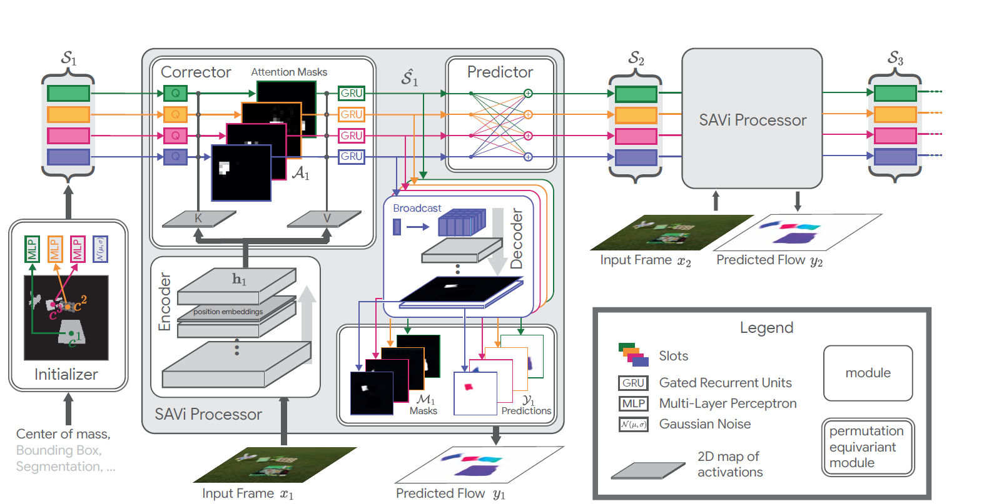
Slot Attention for Video (SAVi) [2]
Extends slot attention to videos.
Instead of random initialization, slots are predicted for next steps and then corrected.

Slide 12
Approach

Slide 13
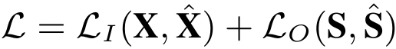
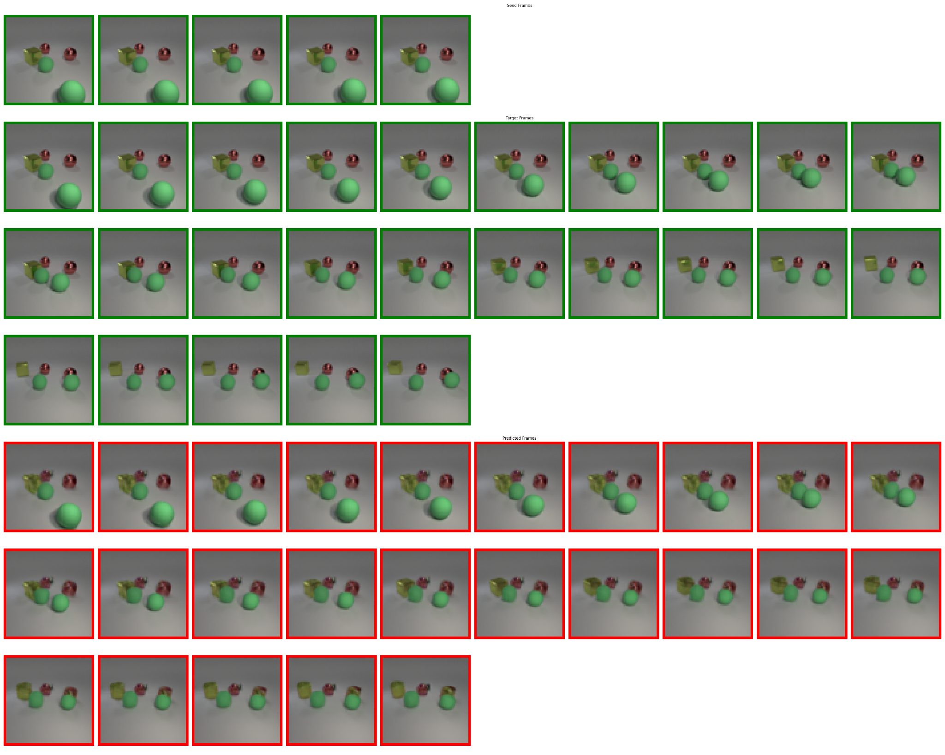
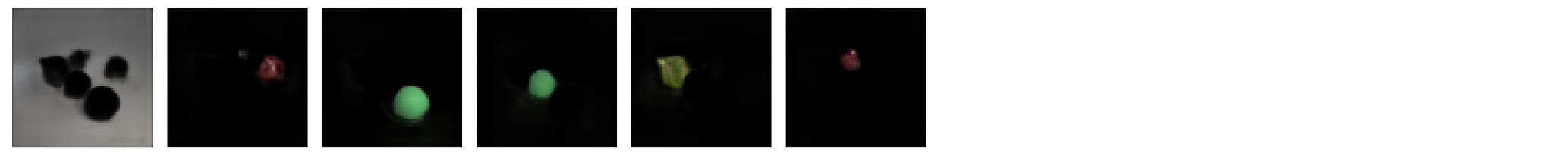
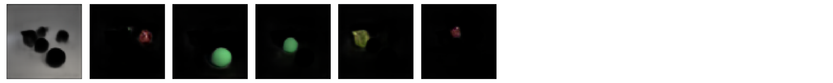
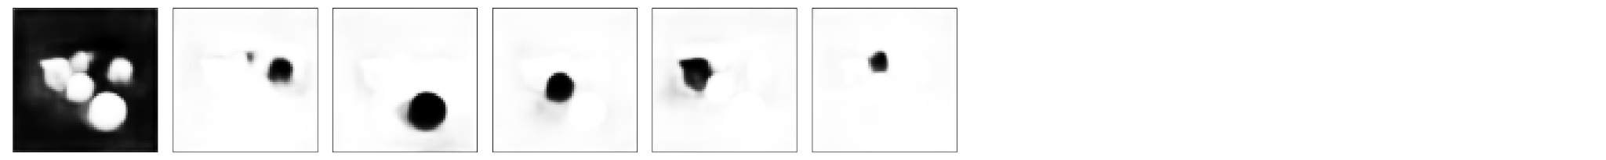
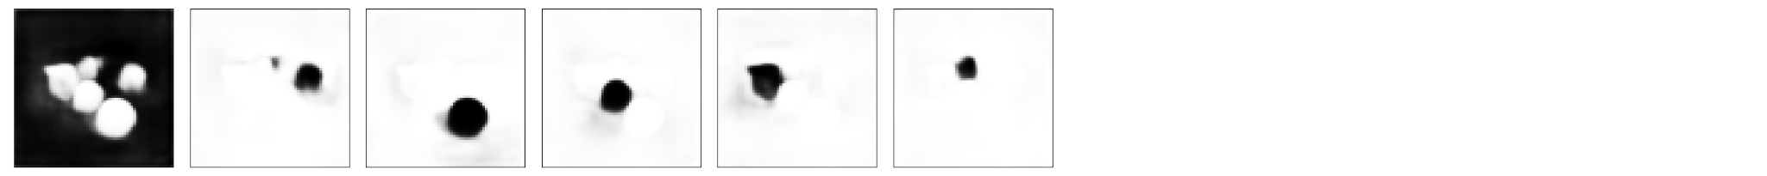
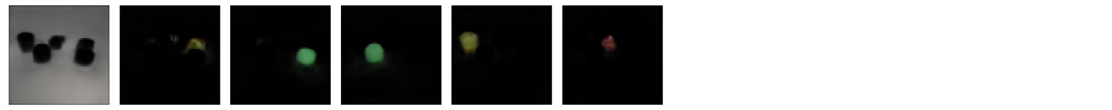
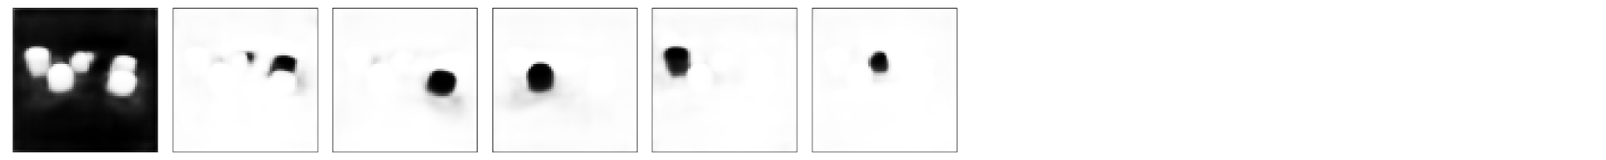
Proposed Approach
Object-
Centric
Predictor
Object
Encoder
Input 1
Slots 1
Object Rendering
⨉
∑
⨉
Object Rendering
⨉
Object
Encoder
Object
Decoder
Predicted slots C+1
Predicted frame C+1
Input C
Slots C
Object Rendering
⨉
∑
Object Rendering
⨉
Object
Decoder
⨉
Predicted slots C+1
Predicted slots C+2
Predicted frame C+2
Object Rendering
⨉
∑
Object Rendering
⨉
Object
Decoder
⨉
Predicted slots C+T-1
Predicted slots C+T
Predicted frame C+T

Slide 14
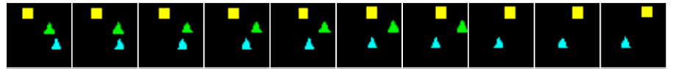
Slot Attention Approach
Encode and decode each frame separately using Slot Attention Model
Need arises for aligning slots to find the same object over different time steps
1. Encoding
2. Scoring Slots
3. Hungarian & Alignment
Slots 1
Slots 2
Alignment Matrix
0.1
0.9
0.2
1.0
0
1
0
0.2
0.2
0.8
Encoder
Encoder
0
0
1
0.9
0.2
0.2
0.0
1
0
0

Slide 15
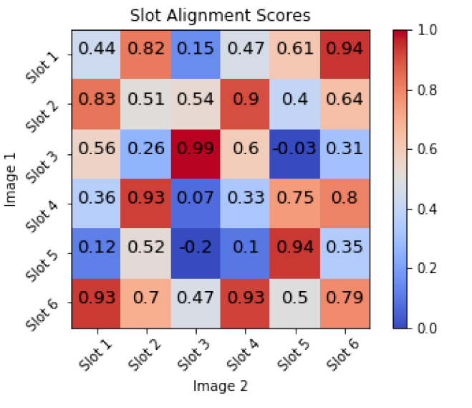
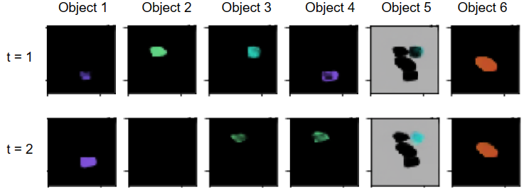
Slot Alignment Problems
Experimented with L2-distance and cosine-similarity for comparing slots.
Initial experiments with slot alignment did not show promising enough results for the prediction task.

Slide 16
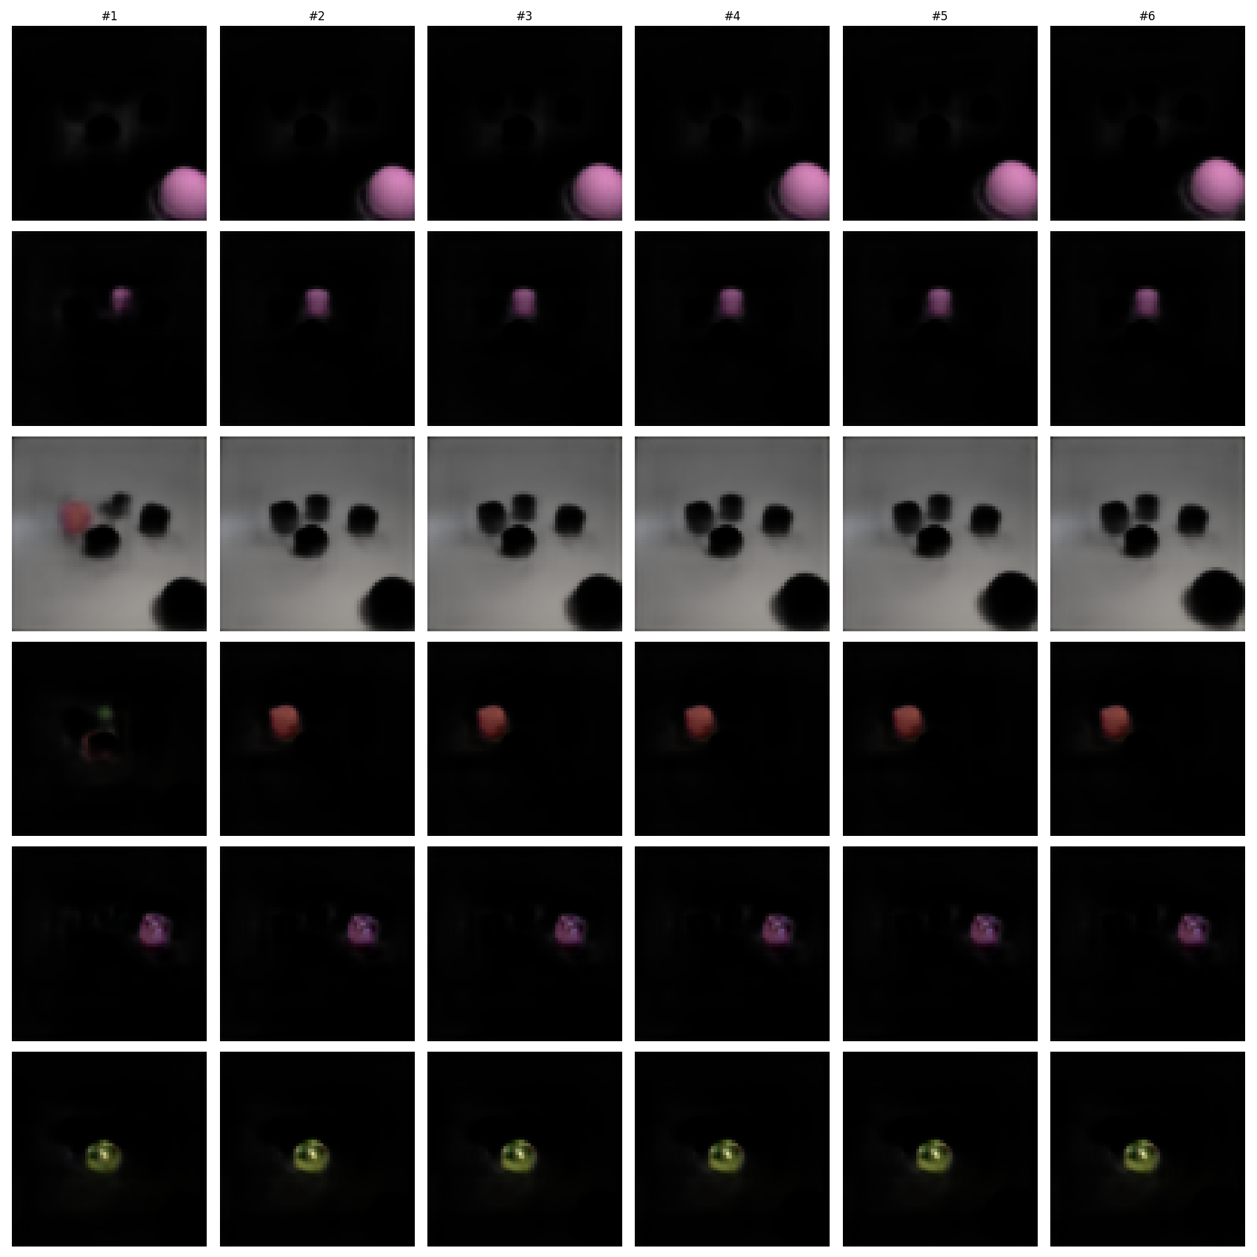
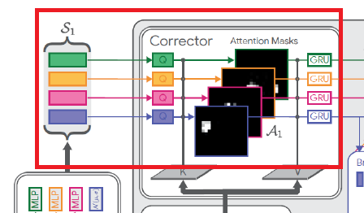
Switch to SAVi
SAVi works directly on frame sequences, and uses slots of one time step to initialize the next.
Result: Slot attention mechanism automatically produces aligned slots.

Slide 17
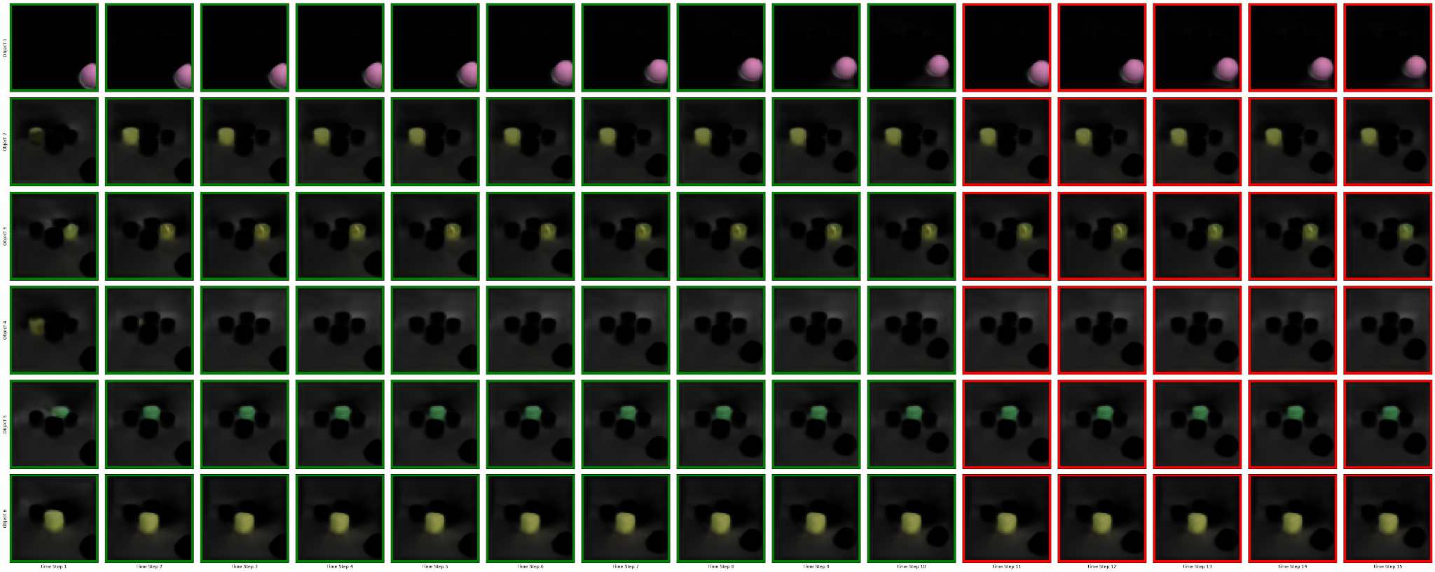
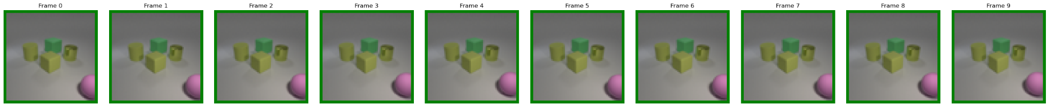
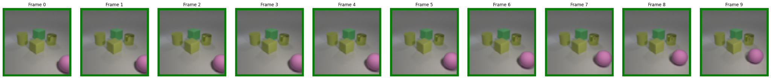
Object-Centric Prediction
Pre-trained Components of SAVi Model
Object Slots 1
Encoder
Predicted Slots
Input 1
Predictor
Slot
Decoder
C
Object Slots T
Encoder
Predicted Frame
Input T
Predicted Objects

Slide 18
Predictor Modules

Slide 19
RNN Predictor
Slots
Predicted Slots
Works for aligned single slots at the time
For N slots, we need N RNN predictor modules
Carries the motion information in its hidden states
Cannot model interaction between objects
We implement it using LSTM cells
RNN
RNN
RNN
Seed Stage: Initializing RNN states
Predict Stage: Using state to predict future slots
RNN
RNN
RNN
RNN
Seed Slots
Predicted Slots

Slide 20
Vanilla Transformer
+
Input consists of all slots in all time steps
Slots simultaneously attend to all previous slots in all previous time steps, i.e., histories of its own and of all other slots
Positional encoding along time dimension
Attention complexity is O(N² * T²)
N: number of slots
T: number of time steps
MLP
Layer Norm
Masked Multi Head Attention
Layer Norm
Positional Encoding

Slide 21
Sequential Object-Centric Transformer
Attention is split into two sequential operations
Object attention: slots attend to all other slots in the same time step
Time attention: slots attend to same slot for all previous time steps (requires alignment)
Attention complexity is O(N² + T²)
N: number of slots
T: number of time steps
+
MLP
Layer Norm
Time Attention
Layer Norm
MLP
Layer Norm
Object Attention
Layer Norm
Positional Encoding

Slide 22
Parallel Object-Centric Transformer
Applying both object-attention and time-attention in parallel. Attention modules are same as in the sequential version.
This module has fewer learnable parameters and less computations than the sequential version.
Attention complexity is O(N² + T²)
N: number of slots
T: number of time steps
+
MLP
Layer Norm
+
Object Attention
Time Attention
Layer Norm
Positional Encoding

Slide 23
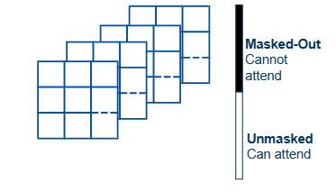
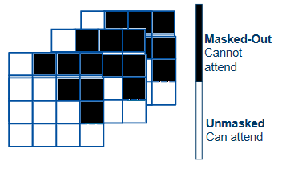
Spatial and Temporal Attention Masks
Vanilla Attention
Object Attention
Temporal Attention
Img 1
0
0
0
.
0.
.
0.
.
0.
Masked-Out
Cannot attend
Img 2
0
0
0
0
0
0
.
0.
.
0.
.
0.
.
0.
.
0.
.
0.
Img 3
0
0
0
0
0
0
0
0
0
.
0.
.
0.
.
0.
.
0.
.
0.
.
0.
.
0.
.
0.
.
0.
Unmasked
Can attend
Img 4
0
0
0
0
0
0
0
0
0
0
0
0
.
0.
.
0.
.
0.
.
0.
.
0.
.
0.
.
0.
.
0.
.
0.
.
0.
.
0.
.
0.
Batch-wise Implementation

Slide 24
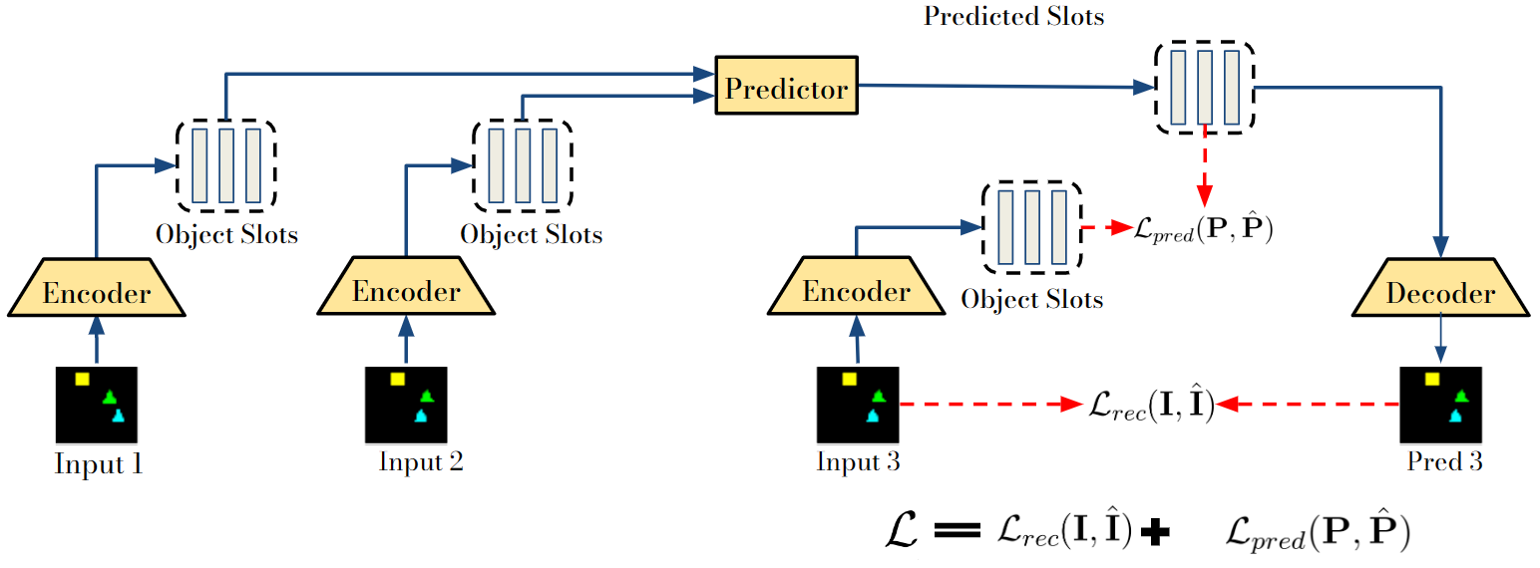
Loss Function
Loss function equally focuses on predicting slot predictions that are similar to the models output, and them being decodable to the correct reconstruction of the future.

Slide 25
Experimental Setup and Results

Slide 26
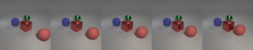
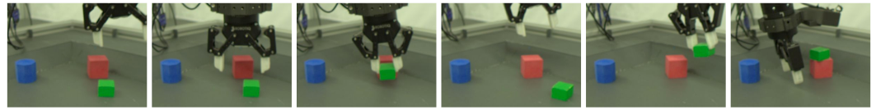
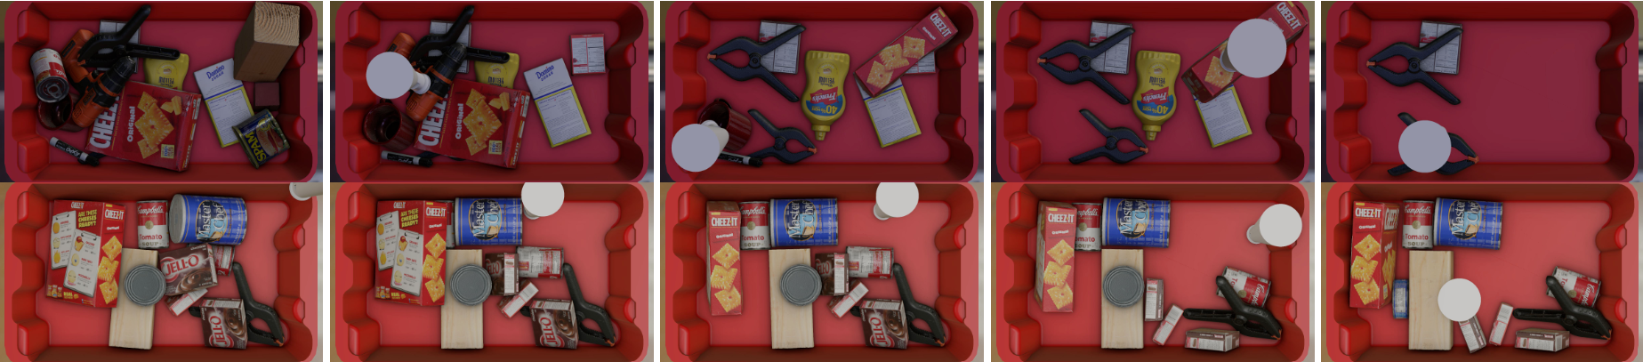
Datasets
Obj3d
Synthetic 3D objects
64x64 pixel frames
Sketchy
Real videos of mechanical gripper
80x120 pixel frames
SynPick
Synthetic mechanical arm performing bin picking
64x112 pixel frames

Slide 27
Object Deconstruction Results

Slide 28
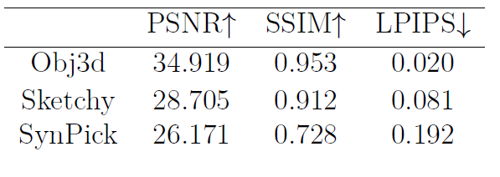
SAVi Training
Trained SAVi models for Obj3D, Sketchy, and SynPick
Variations in dataset complexity leeds to variation in results and model parameters
Evaluation of SAVi instances trained on used datasets (averaged over sequence length used per dataset).

Slide 29
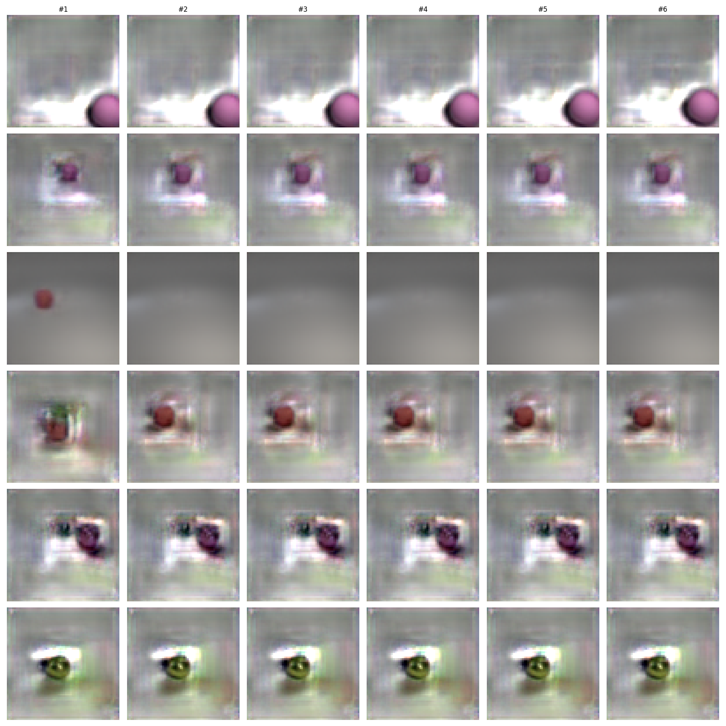
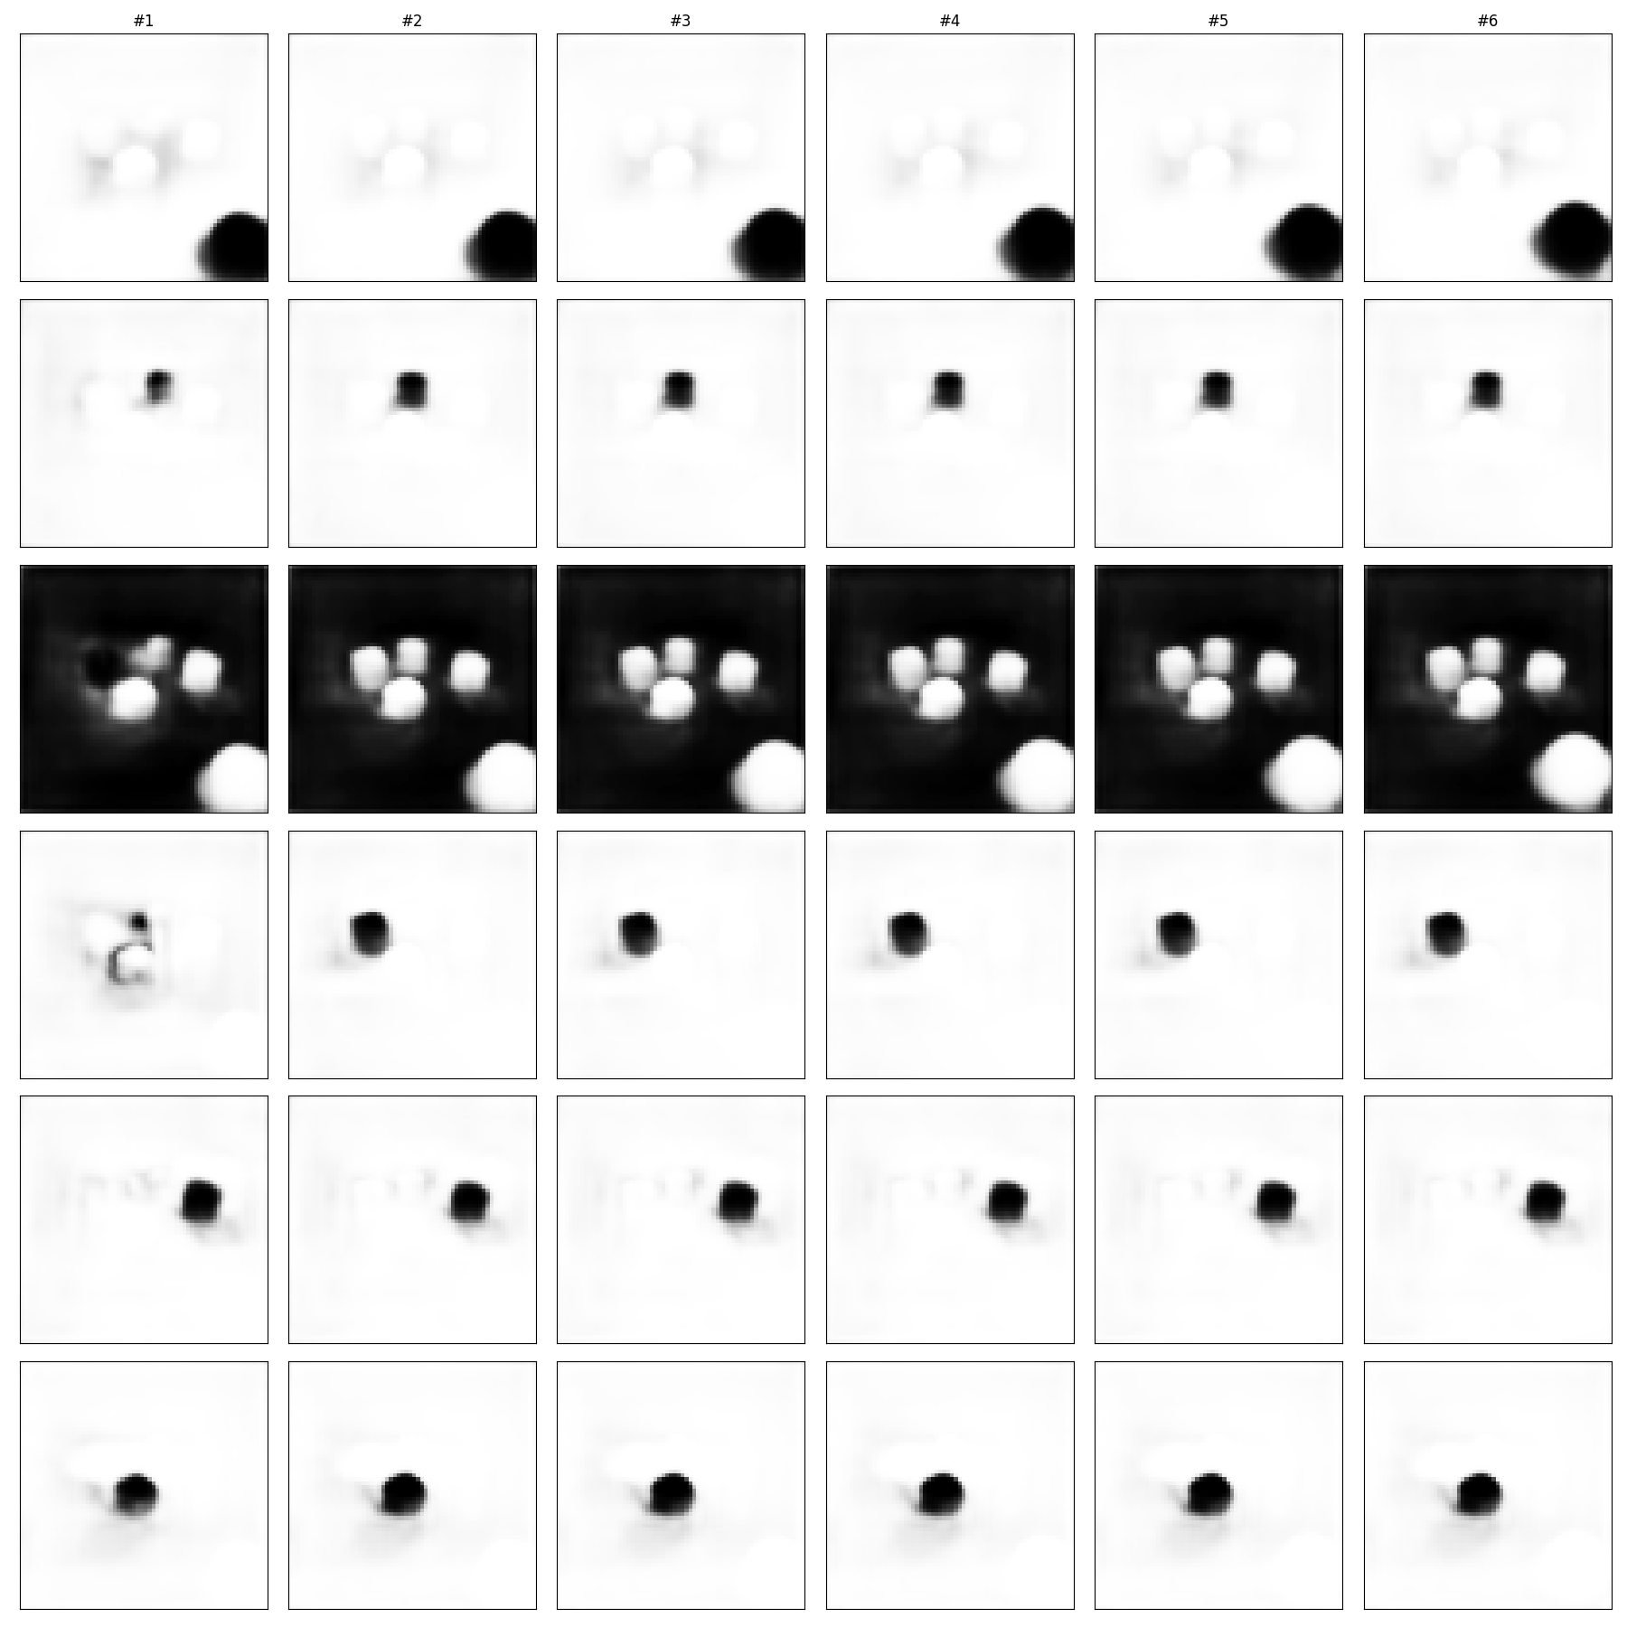
SAVi Results: Obj3D

Slide 30
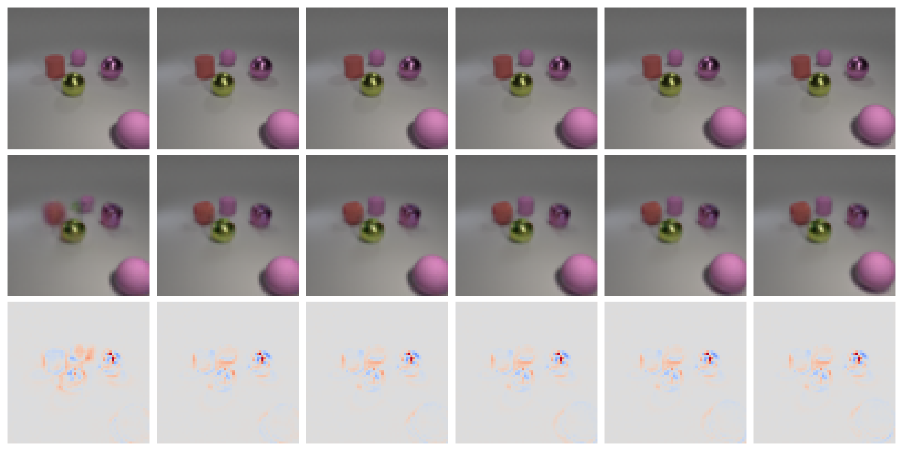
SAVi Results: Obj3D

Slide 31
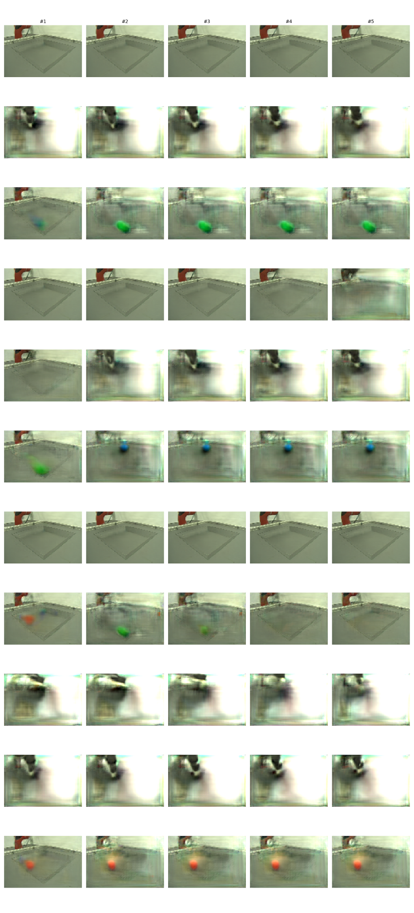
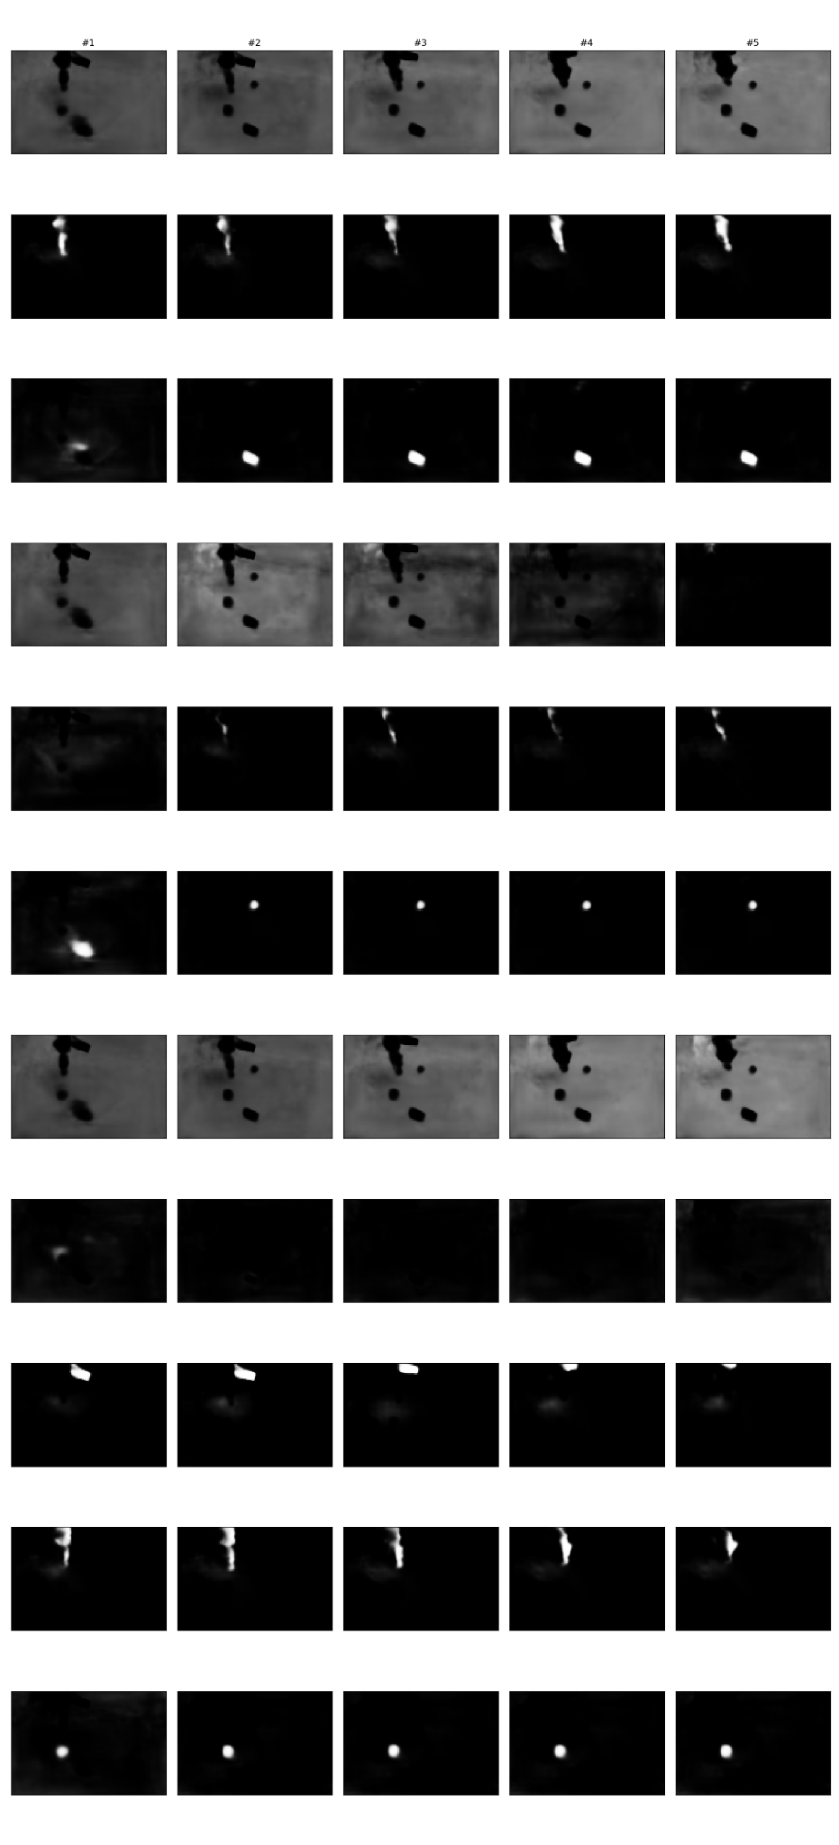
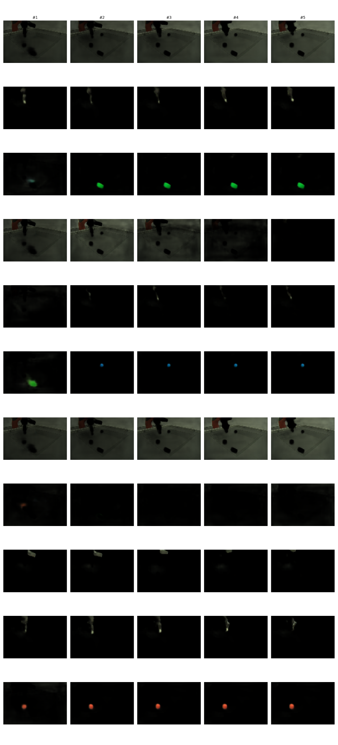
SAVi Results: Sketchy
…
…
…

Slide 32
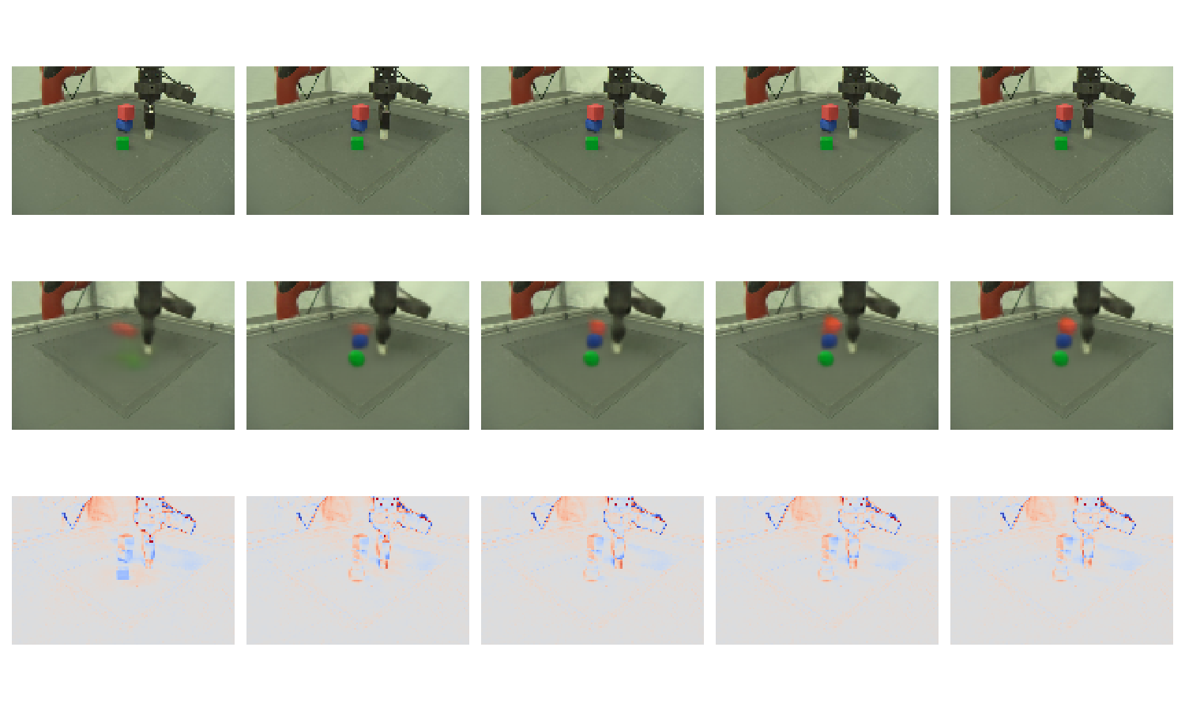
SAVi Results: Sketchy

Slide 33
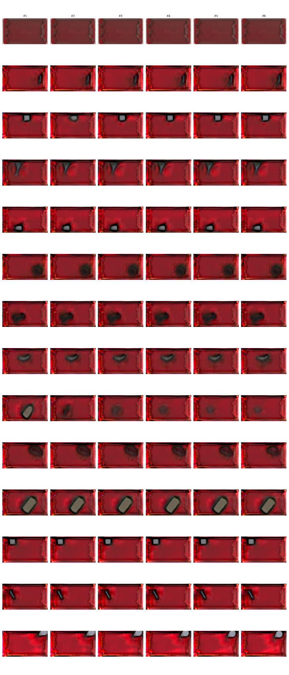
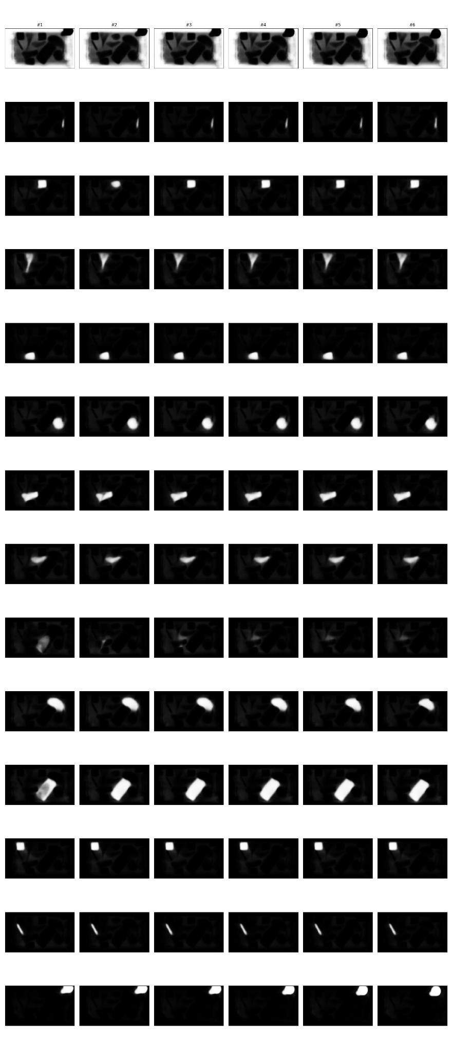
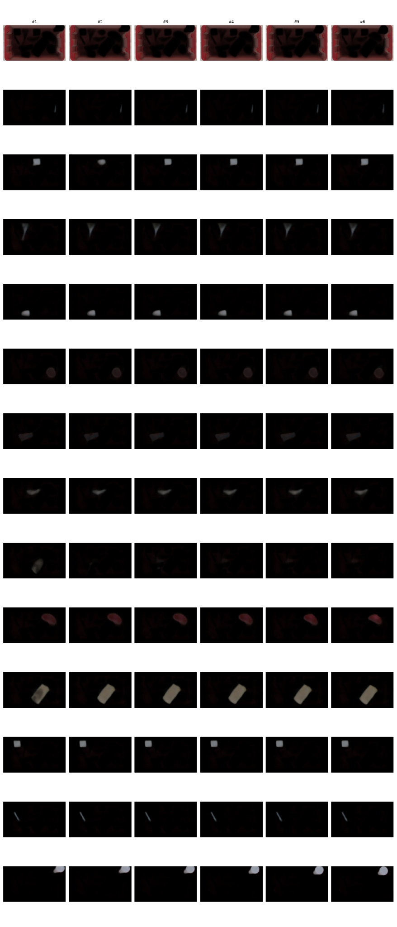
SAVi Results: SynPick
…
…
…

Slide 34
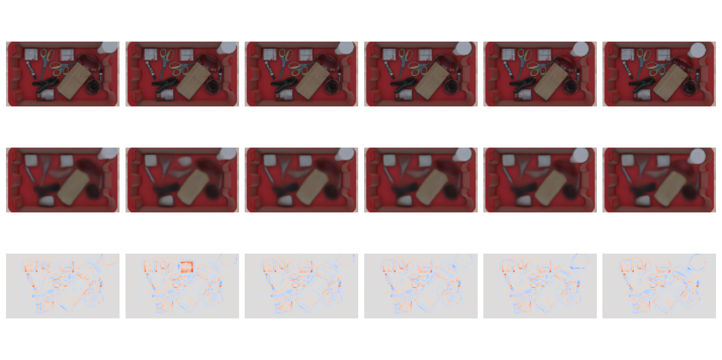
SAVi Results: SynPick

Slide 35
Prediction Experiments

Slide 36
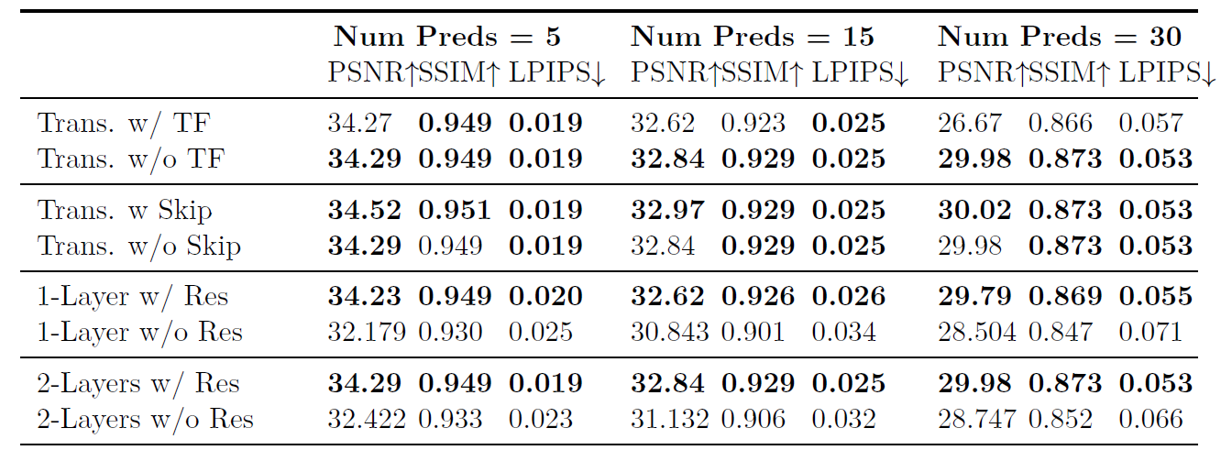
Vanilla Transformer Ablation Studies: Results
Ablation studies on Obj3D

Slide 37
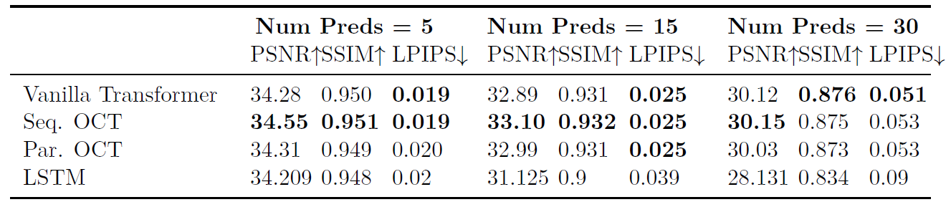
Predictors Results and Comparisons: Obj3D

Slide 38
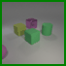
Predictors Results and Comparisons: Obj3D
LSTM
Vanilla Transformer
Ground Truth
Seq. OCVT
Parallel OCVT

Slide 39
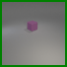
Predictors Results and Comparisons: Obj3D
LSTM
Vanilla Transformer
Ground Truth
Seq. OCVT
Parallel OCVT

Slide 40
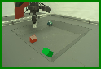
Predictors Results and Comparisons: Sketchy
LSTM
Vanilla Transformer
Ground Truth
Seq. OCVT
Parallel OCVT

Slide 41
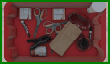
Predictors Results and Comparisons: SynPick
LSTM
Vanilla Transformer
Ground Truth
Seq. OCVT
Parallel OCVT

Slide 42
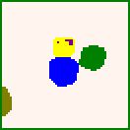
Segmentation Prediction on Obj3D
LSTM
Vanilla Transformer
Ground Truth
Seq. OCVT
Parallel OCVT

Slide 43
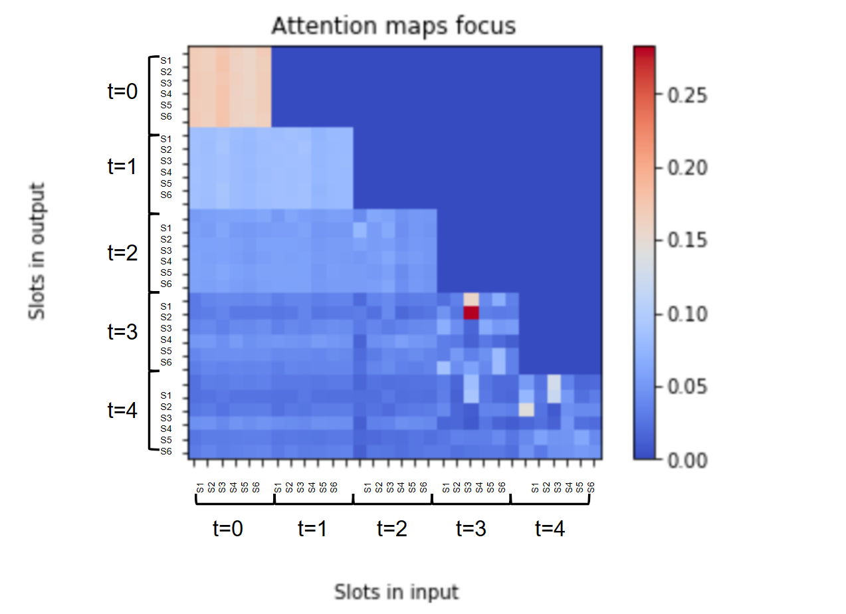
Predictor Attention Masks: Vanilla Transformer

Slide 44
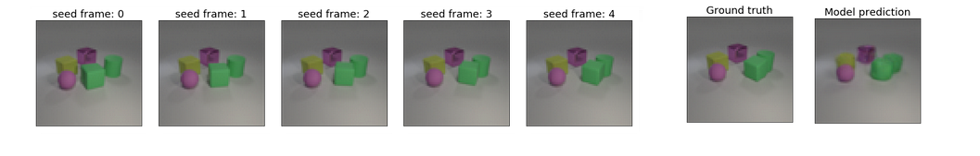

Predictor Attention Masks: Vanilla Transformer

Slide 45



Predictor Attention Masks: Sequential OCVT

Slide 46

Predictor Attention Masks: Sequential OCVT

Slide 47

Predictor Attention Masks: Sequential OCVT

Slide 48
Conclusion
We propose a fully self-supervised object-centric learning approach for video prediction
We combine Slot Attention mechanism with predictor modules
We introduce two novel object-centric transformers for prediction
Object and time attention blocks are separated
More efficient
Better Results
Seperation of time and object attentions shows learned object dynamics and interactions, providing interpretable results

Slide 49
Literature
[1] Locatello, Francesco, et al. "Object-centric learning with slot attention." Advances in Neural Information Processing Systems 33 (2020): 11525-11538.
[2] Kipf, Thomas, et al. "Conditional object-centric learning from video." arXiv preprint arXiv:2111.12594 (2021).
[3] Wu, Yi-Fu, Jaesik Yoon, and Sungjin Ahn. "Generative Video Transformer: Can Objects be the Words?." International Conference on Machine Learning. PMLR, 2021.
[4] Utilizing key point and pose estimation for the task of autonomous driving, Waymo blog. Link: https://blog.waymo.com/2022/02/utilizing-key-point-and-pose-estimation.html

Slide 50

Thanks for your
Questions?

Slide 51
Appendix

Slide 52
Datasets

Slide 53

Datasets: Video Multi-dSprites (VMDS)
Dataset consisting of simple two dimensional geometric shapes
10 frame videos with a maximum of 5 free moving objects
64x64 pixel frames
Too simple, used for initial experiments in training Slot Attention and in slot alignment

Slide 54
Datasets: Obj3D
Video extension of the CLEVR dataset
Includes colourful three dimensional objects on a gray plane
Complexities: lightning direction, occlusions in 3D, collisions, acceleration
64x64 pixel frames

Slide 55
Datasets: SynPick
Synthetic dataset, designed for the task of bin picking
Videos of a mechanical arm picking up objects inside a box
Challenging dataset: movement of an active agent that makes decisions, high number of objects, collisions and occlusions
64x112 pixel frames

Slide 56
Datasets: Sketchy
Real video dataset, designed for the task of picking and stacking objects.
Videos of a mechanical gripper picking up objects on a flat surface and moving them.
Movement of an active agent, but fewer objects. Gripper has more complex structure than in SynPick
80x120 pixel frames

Slide 57


Slot Attention
Decomposes image into its object components
Working with individual images
No sequential processing
Object Slots
Encoder
Decoder
Input
Recons.

Slide 58
Slot Alignment
Slot Attention factorizes image into unordered Slots
Slots from consecutive images must be aligned temporally:
Computite affinity between scores (e.g. norm.cosine similarity)
Find bipartite match with Hungarian algorithm
Recovering slots for temporal alignment
1. Encoding
2. Scoring Slots
3. Hungarian & Alignment
Slots 1
Slots 2
Alignment Matrix
0.1
0.9
0.2
1.0
0
1
0
0.2
0.2
0.8
Encoder
Encoder
0
0
1
0.9
0.2
0.2
0.0
1
0
0

Slide 59

Slot Alignment

Slide 60


Slot Alignment (Fixed Slot Number)

Slide 61
Prediction Flow for RNN and MLP
Aligning slots of seed frames
Autoregressive prediction of future slots
Alignment during seed stage
Predicted slots are already ‘aligned’
1)
1.0
2)
0.1
0.9
0.2
RNN
RNN
RNN
RNN
0.2
0.2
0.8
0.9
0.2
0.2
Seed Stage
Prediction Stage
0.0

Slide 62








Seed Frames
Predictor
Object
Centric
Encoder
Object
Centric
Decoder
…
Predicted Object Representations
Encoded Object Representations
…
Reconstructed Predicted Frame

Slide 63

SAVi Training
VMDS used for experimentation with the setup
Trained SAVi models for Obj3D, Sketchy, and SynPick
Variations in dataset complexity leeds to variation in results and model parameters

Slide 64

Predictors Training
Predictor training depends like-wise on complexity of dataset, and parameters of the pre-trained SAVi model used

Slide 65



SAVi Results: Relation to Time Step
Average metric results of SAVi instance trained on Obj3D per time-step of provided video segment.

Slide 66

Predictor Attention Masks: Vanilla Transformer

Slide 67

Predictor Attention Masks: Vanilla Transformer

Slide 68








N
+
N
+
N
+
MLP
Layer Norm
MLP
MLP
+
Layer Norm
Temporal Attention
Layer Norm
Layer Norm
+
+
+
MLP
+
Layer Norm
Relational Attention
Temporal Attention
Masked
Attention
+
Relational Attention
Layer Norm
Layer Norm
Layer Norm

Slide 69
Vanilla Transformer Ablation Studies: Conclusions
Teacher forcing is helpful in the first few frames, but for a longer prediction it hinders the model’s ability to handle its own imperfect predictions
Skipping the first time step does not have much effect
Without residual connections, the model cannot go deeper than 2 transformer layers without overfitting
Residual connections improve overfitting issues. 4 and 6 layer transformers see much better results.

Slide 70

Predictors Ablation Studies: Other Predictors
Using what we learned about transformer predictor training, we perform further studies using our novel object-centric transformers
We perform experiments using number of layers for each predictor to see the optimal configuration for prediction

Slide 71
Predictors Results and Comparisons: Obj3D

Slide 72

Predictors Results and Comparisons: Sketchy

Slide 73

Predictors Results and Comparisons: SynPick

Slide 74

Predictors Results and Comparisons: Obj3D

Slide 75

Predictors Results and Comparisons: Sketchy

Slide 76

Predictors Results and Comparisons: Obj3D

Slide 77

Predictors Results and Comparisons: Obj3D
LSTM
Vanilla Transformer
Ground Truth
Seq. OCVT
Parallel OCVT

Slide 78

Predictors Results and Comparisons: Sketchy
LSTM
Vanilla Transformer
Ground Truth
Seq. OCVT
Parallel OCVT

Slide 79

Predictors Results and Comparisons: SynPick
LSTM
Vanilla Transformer
Ground Truth
Seq. OCVT
Parallel OCVT

Slide 80

Time Attention and Object Dynamics
Attending to an object’s own history is equivalent to learning movement dynamics of the object.
Time attention tends to focus the most on the last state followed by the initial state.

Slide 81



Predictor Attention Masks: Parallel OCVT

Slide 82


Predictor Attention Masks: Parallel OCVT

Slide 83

Predictor Attention Masks: Parallel OCVT

Slide 84
Batch-wise Implementation
Obj. 1
t=0
t=1
t=2
t=3
Obj. 2
Obj. 3
Obj. 1
Obj. 2
Obj. 3
t=0 t=1 t=2 t=3

Slide 85

End-to-End Training
Simultaneous training of slot-decomposition and predictor modules
End-to-end approach
Convergence might be complicated
Train slot-model + joined fine tuning
Predicted Slots
Predictor
Object Slots
Object Slots
Object Slots
Encoder
Encoder
Decoder
Encoder
Encoder
Decoder
Decoder
Input 1
Recons. 1
Input 2
Recons. 2
Input 3

Slide 86
Object-
Centric
Predictor
Object
Encoder
Input 1
Slots 1
Object Rendering
-Centric
Decoder
⨉
∑
⨉
Object
Encoder
Object Rendering
⨉
Object
Decoder
Input C
Predicted slots C+1
Predicted frame C+1
Slots C
Object Rendering
⨉
∑
Object Rendering
⨉
Object
Decoder
⨉
Predicted slots C+1
Predicted slots C+2
Predicted frame C+2
Object Rendering
⨉
∑
Object Rendering
⨉
Object
Decoder
⨉
Predicted slots C+T-1
Predicted slots C+T
Predicted frame C+T

Slide 87
Future Work Ideas
For Robotics scenarios (e.g. as shown in SynPick and Sketchy), integrate robot commands or plans into the prediction
Helps with uncertainty in predicting states of an active agent
Introducing multi-modality to our prediction pipeline to deal with stochasticity of future prediction
Experimenting with more slot initialization approaches, and integration object information more in this process
Experimenting with different loss function and their effects on the prediction
Possible end-to-end training to optimize SAVi representations directly for prediction (Hard to converge)

